Slide 1
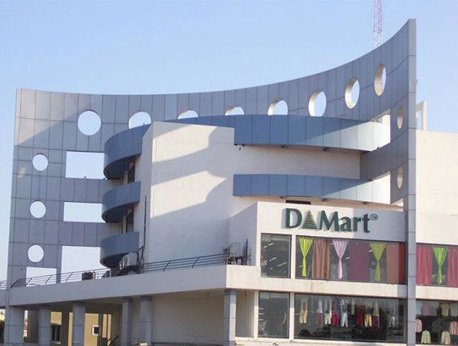


Number of Counters Problem

Slide 2

Group members
Sr. No | Name | Roll no | Prn no
1 | Pushpak Suryawanshi | 272056 | 22010400
2 | Soham Tolwala | 272058 | 22010224
3 | Saiprasad Toshatwad | 272060 | 22010203
4 | Prajwal Waykos | 272063 | 22010591
Bansilal Ramnath Agarwal Charitable Trust’s Vishwakarma Institute of Information Technology, Pune
Department of Artificial Intelligence and Data Science
Notes:
Photo by fauxels from Pexels

Slide 3
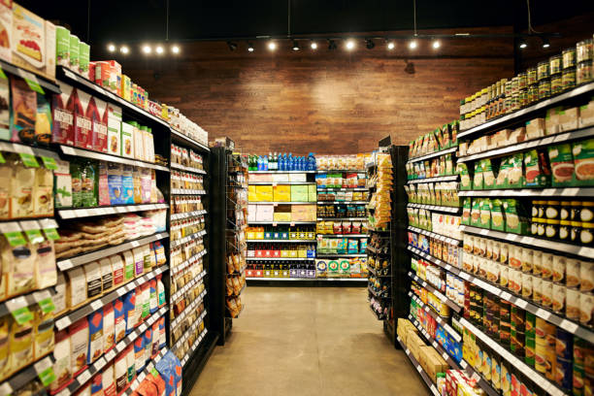
BRIEF
We have been given a task by the owner of Dmart
regarding the business and financial management of the mall.
As data scientists,we have to help him to calculate the
total number of counters in each D/mart mall in main cities of each region of India which will help him to save a lot of extra expenses and revenue.

Slide 4


Slide 5
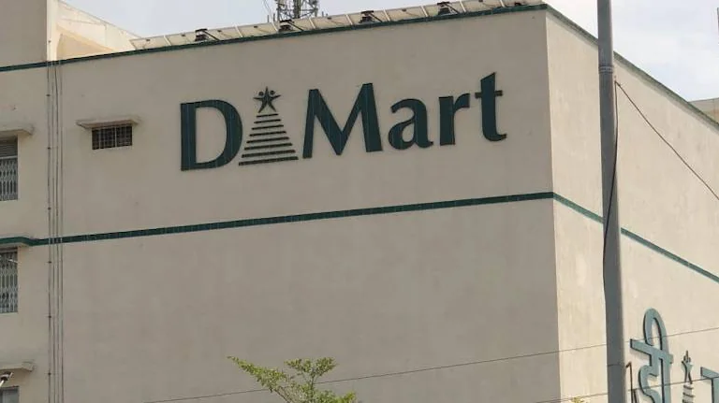
TASK
To collect information and details about each mall in
the main cities of India for further analysis.
To analyse the details and various features of the data and
find out different insights based on it.
To create different types of data models to predict the total
number of counters required in each of the mall.
To compare and analyse the various models and select the
best model that can be used.

Slide 6
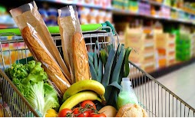
INTRODUCTION
DMART is one of the most popular shopping malls in India.
It is a one -stop supermarket chain that offers customers a wide range of basic home and personal products under one roof in a cheap and reasonable price,and as a result the customers are always attracted towards it and so there is a great demand for the products in the mall,especially in the festive days than other days.
Apart from good quality products,the mall also offers good quality services,such
as helping the customers to buy the right choice of products,increasing the number of counters in the mall during festivals that will help the customers to save their time,instead of standing in the queue for a long time for bill payment.And so the mall pays a large and hefty amount of money to give good quality services to customers.
Thus,our aim as data scientists is to help the owner of Dmart to save his revenue
on the extra services which are not required with the help of various prediction
models.

Slide 7
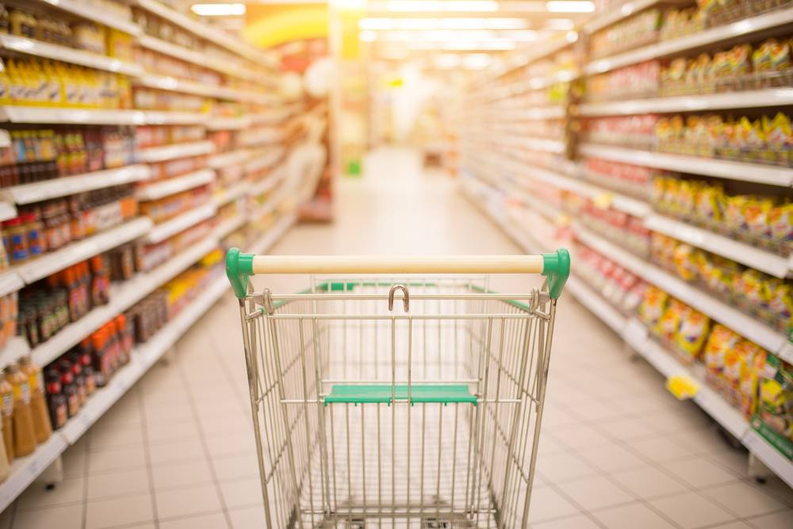
MOTIVATION
Business intelligence and financial management helps the companies and organizations to make better and more accurate and efficient decisions for their future growth.
Our role as data scientists is to make proper use of it and help the owner of the mall to make better decisions that will save his revenue and expenses.

Slide 8

RESOURCES
We have been given the information of the mall located in each of the main cities of India.
Since raw data cannot be read by the algorithm,so using the information we have sorted it into different categories and
we created a dataset which will help us to create the model.
This dataset contains various parameters and fields such as the region and city in which the mall is located,the number of outlets in each city,the sales revenue of the mall,and the profit gained by it.
Thus using this dataset, and other software like vscode(to compute the code),tableau(to create visualizations),etc we are going to create different
prediction models.

Slide 9
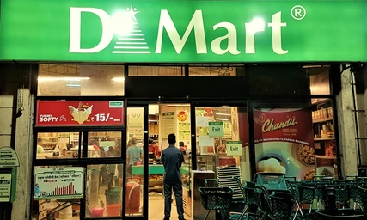
PROPOSED WORK
We have divided the problem statement into two parts,i.e data creation and model building.
The data creation part includes defining the various data variables also called as features and second is the creation of records with respect to the different attributes using the dataset.
Using the above dataset and records we create various prediction models to find out the number of counter boys that should be employed in order to meet the long queue problem.

Slide 10
Working Flow
DMart number of counters problem
Data Creation
Model Building
Defining Various Features
Creating Records
Trying out various Models
Implementing Finalized model

Slide 11
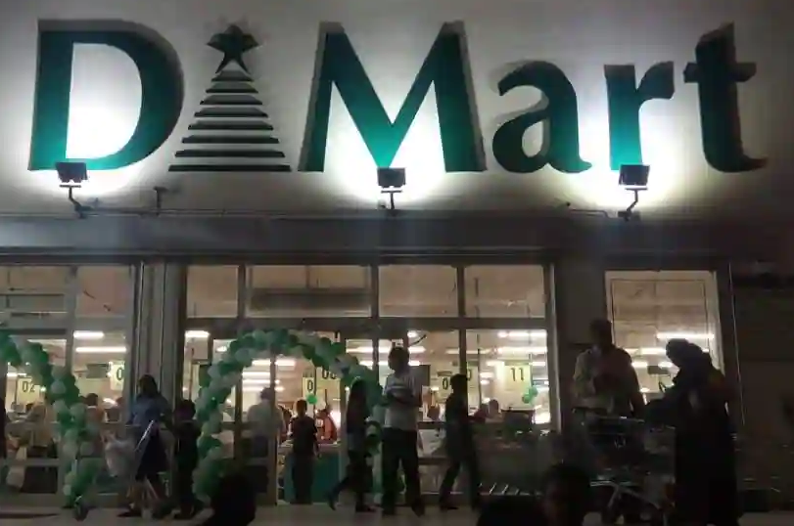
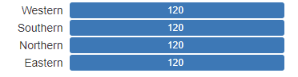
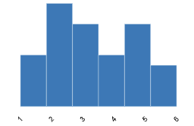
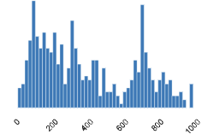
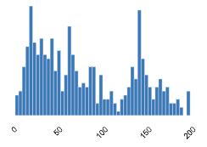
Data Creation
01
REGION
02
OUTLETS
03
SALES
04
PROFIT

Slide 12
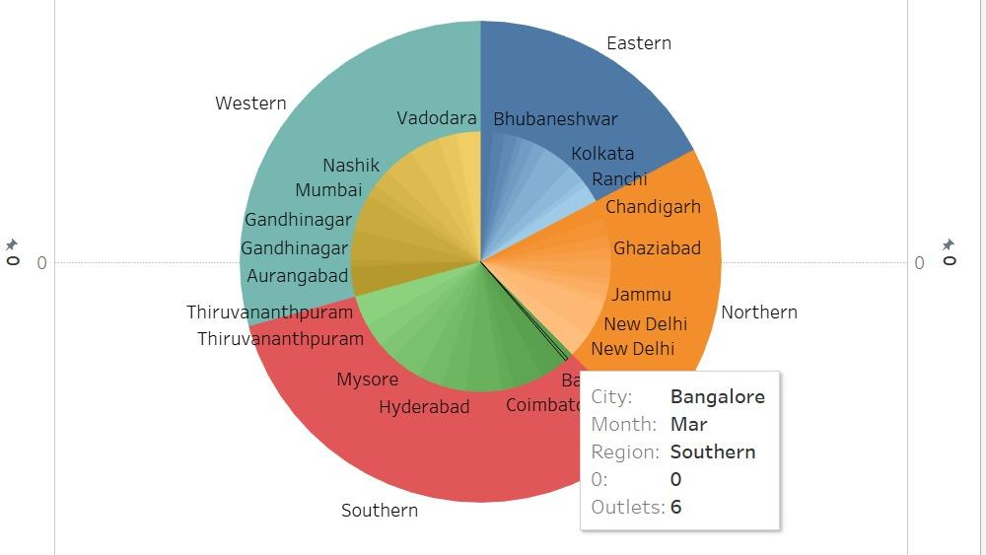
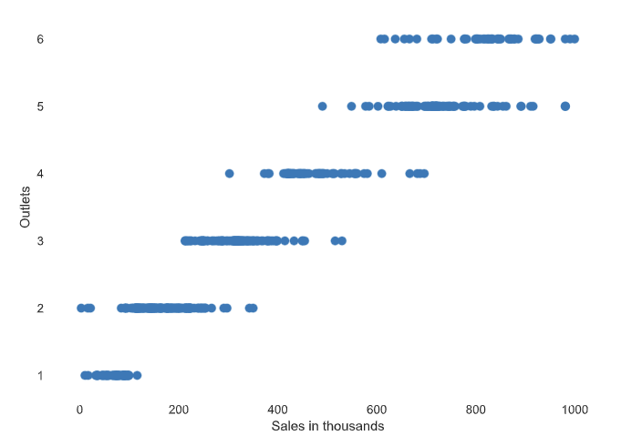
Graphs created using preprocessed data

Slide 13
Model Building
mean squared error
Performance Metrics
Trying out various models
R Squared Score
models:
1. Linear Regression
2.Ridge Regression
3. Lasso Regression
Model Building
LOCATION:
Region, City
INPUT
Implementing Finalized models
Time
Month number
OUTPUT
Number of counters

Slide 14
Concepts used from syllabus
For Data structures , we have used the concepts of arrays(numpy arrays) extensively to work and process data.
also , we have implemented the python lists, python key value pairs(Dictionaries) many more python inbuilt functions which are in turn written in the forms of various data structures
For DM, we have used various machine learning algorithms such as Linear Regression, Ridge Regression etc.
Also , We have used a whole lot of statistical tools such as mean, variance, standard deviation.
We also have implemented some performance metrics such as negative mean squared errors and R squares.

Slide 15
CONCLUSION
Thus,we have collected information and details about each D/mart mall in the main cities of various regions in India.
Then we have analyzed the details and various features of the data and find out different insights based on it.
We have also created different types of data models to predict the total number of counters required in each of the mall.
The algorithm is able to predict the number of counters based upon the given input of city, Region and Month.
Also we concluded that given the dataset and the other conditions the Ridge Regression works the best followed by Lasso and Linear regression.

Slide 16
REFERENCES
1) Link of the dataset:-https://in.docworkspace.com/d/sIM3csc1juZ-7jQY
2) Python and Vs code software to compute the code and create the model.
3) Google-To get images of the mall.
4)Animaker-To create animated video.

Slide 17
THANK YOU

